Slide 1
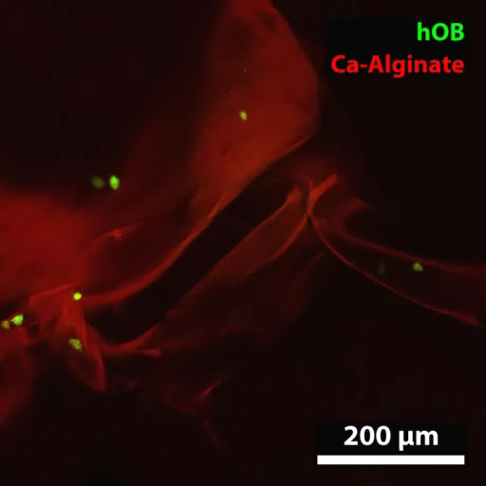
Video S1. 3D reconstruction confocal images of hOBs @ Ca-Alginate scaffolds showed that cells were dispersed in an identical pattern.

Slide 2
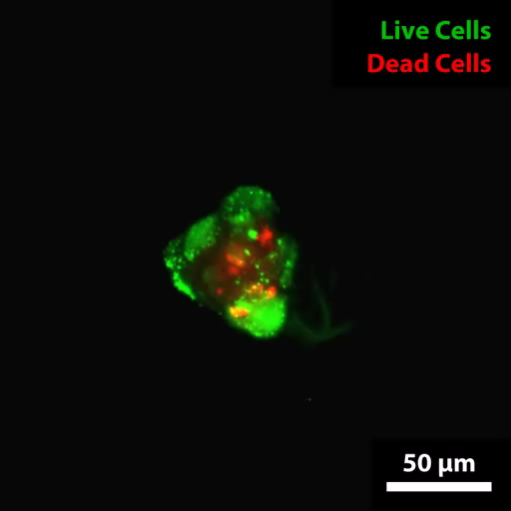
Video S2. 3D corresponding animated movie of hOBs @Ca-Alginate scaffolds w/o perfusion at Day 7.

Slide 3
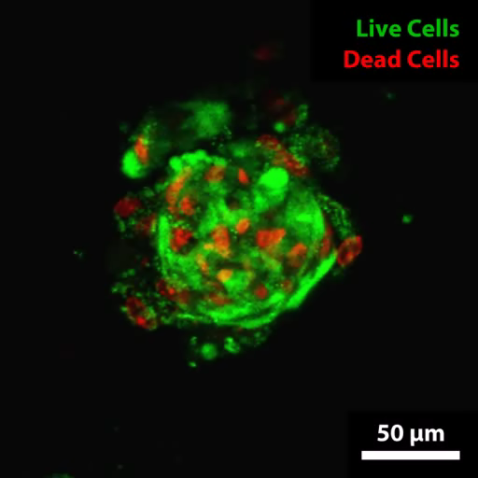
Video S3. 3D corresponding animated movie of hOBs @Ca-Alginate scaffolds w/o perfusion at Day 14.

Slide 4
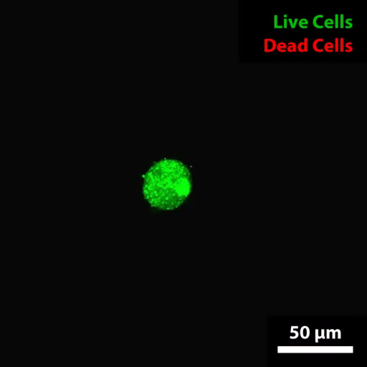
Video S4. 3D corresponding animated movie of hOBs @Ca-Alginate scaffolds w/ perfusion at Day 7.

Slide 5
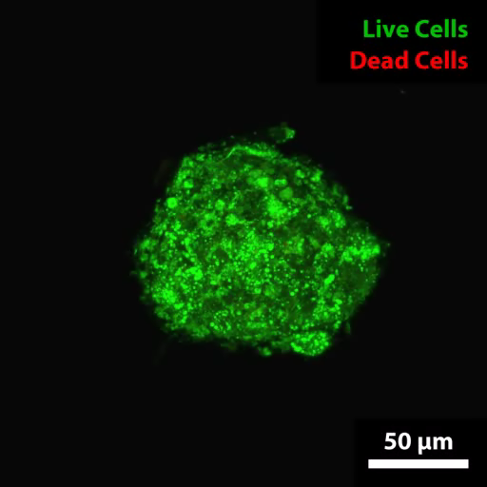
Video S5. 3D corresponding animated movie of hOBs @Ca-Alginate scaffolds w/ perfusion at Day 14.

Slide 6
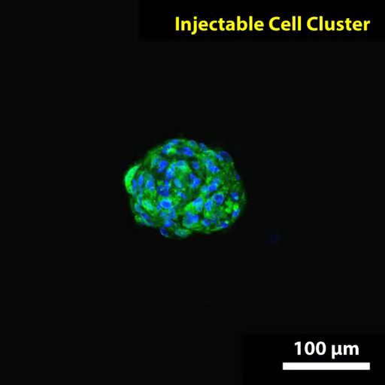
Video S6. 3D reconstruction and cross-section of the bone-like tissue.

